Slide 1

An Analysis of first impressions
Kristie Boynton
Koya Saito
Yifan Zhang

Slide 2
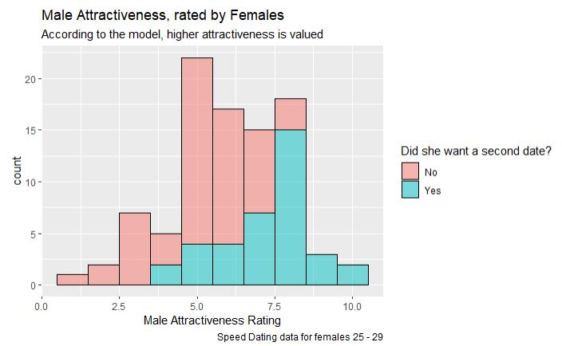
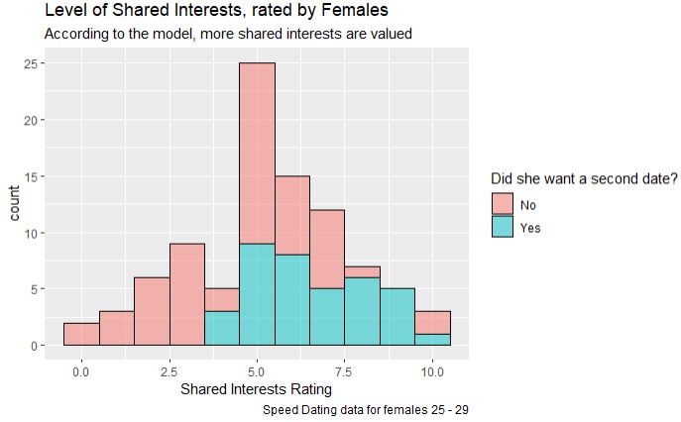
Trait Significance by Groups of people
Example Visualizations
Females 25-29: adj. R² = .327, r = .572
p.decision = -0.56678 + 0.12(Attractiveness) + .0503(Shared Interests)
What traits are useful for predicting when a person will want a second date? Does this change by group?
Use multiple regression to find the simplest, most accurate models that use traits to predict the decision
Groups are female/male, ages 20-24, 25-29, 30+
Traits in question are attractiveness, sincerity, intelligence, fun, ambition, and shared interests

Slide 3
Results and Conclusions
Younger groups tended to value attractiveness more than other traits
Attractiveness coefficient >0.1 in 20-24 groups
Other traits show up (positively) more in group 30+
Women tended to value more traits than just attractiveness
Even in early 20s, shared interests was included
Male models valued attractiveness (with coefficient >0.1) in every model, with few other significant predicting traits
Males 20-24: adj. R² = 0.241
p.decision = .33 + .1695(Attractive) - .1094(Intelligent)
Males 25-29: adj. R² = 0.306
p.decision = -.64 + .1732(Attractive)
Males 30+: adj. R² = 0.324
p.decision = .056 + .14(Attractive)- .11(Intelligent) + 0.065(Shared Interests)
Females 20-24: adj. R² = 0.292
p.decision = -.63391 + .064(Attractive)+ .088(Intelligent) - .064(Ambition)+ .082(SharedInterests)
Females 25-29: adj. R² = .327
p.decision = -0.56678 + 0.12(Attractiveness) + .0503(Shared Interests)
Females 30+: adj. R² = 0.250
p.decision = .172 - .13(Sincere)+ .15(Ambition) + .07(Shared Interests)

Slide 4
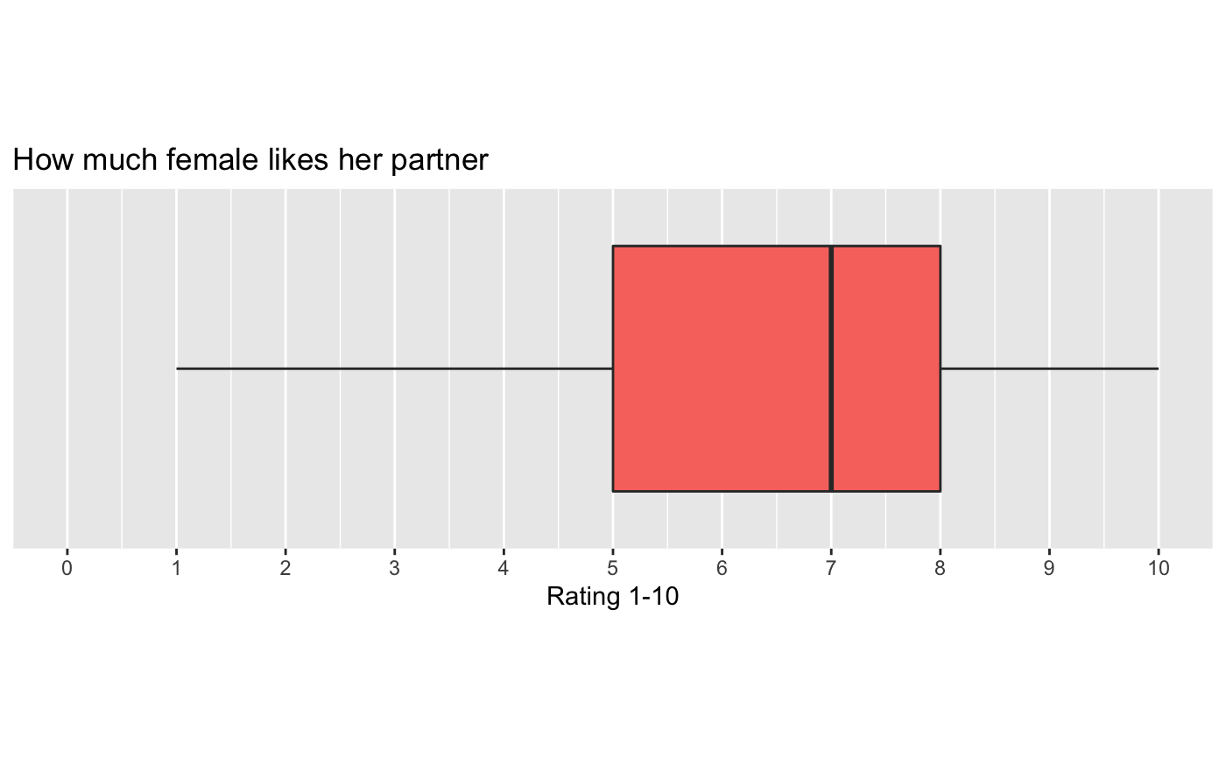
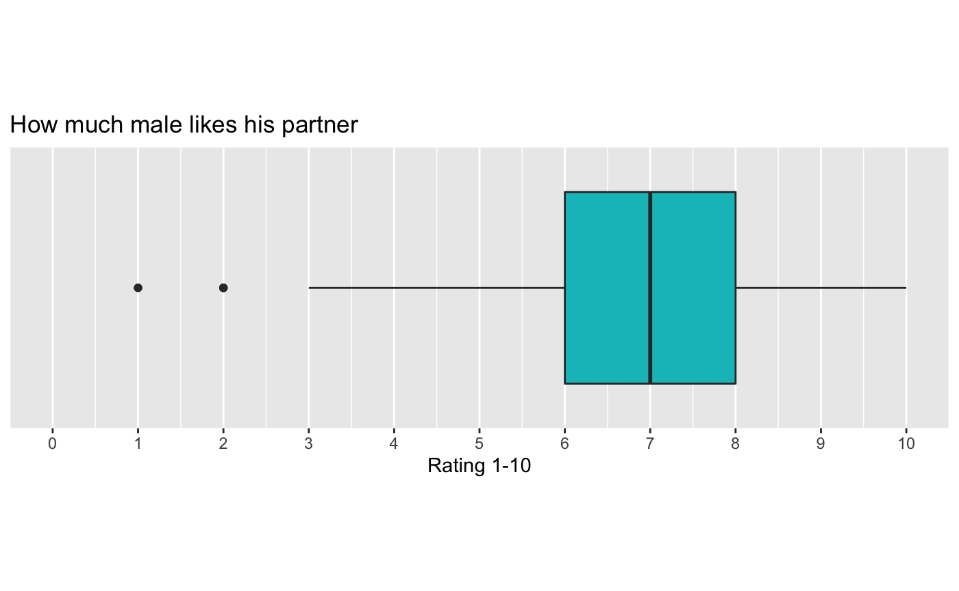
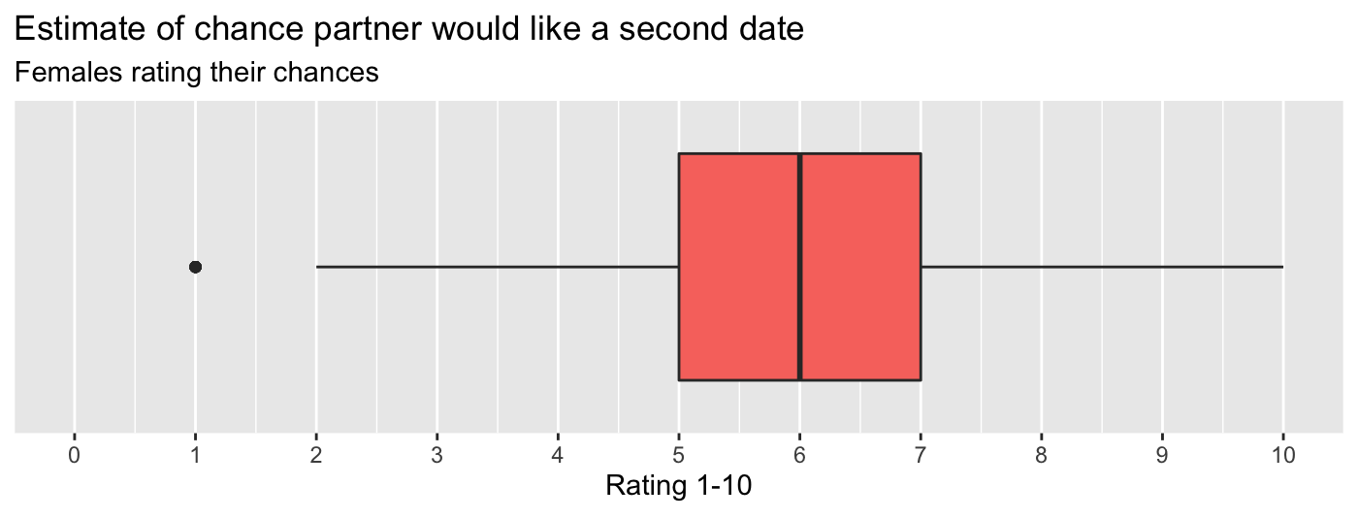
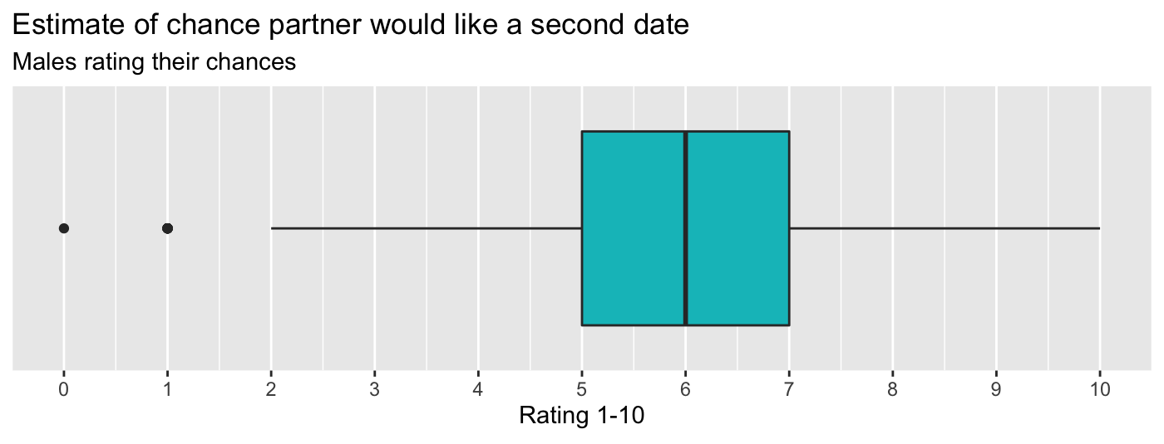
Self-Confidence versus perception
How good are we at rating ourselves? Is there a difference in how women and men rate themselves?
“How does a person’s rating of themselves compare to their partner’s actual rating”
Approach:
Understand related metrics and drawing connections to confidence levels
Visualize data, marking characteristic elements
Predictions
Men will tend to overestimate their chances
A high (7-10) rating will be required from each party to go on a second date
Notes:
Something interesting to note here is in the box plots. Both genders tended to rate their chances lower than they rated their partner.

Slide 5
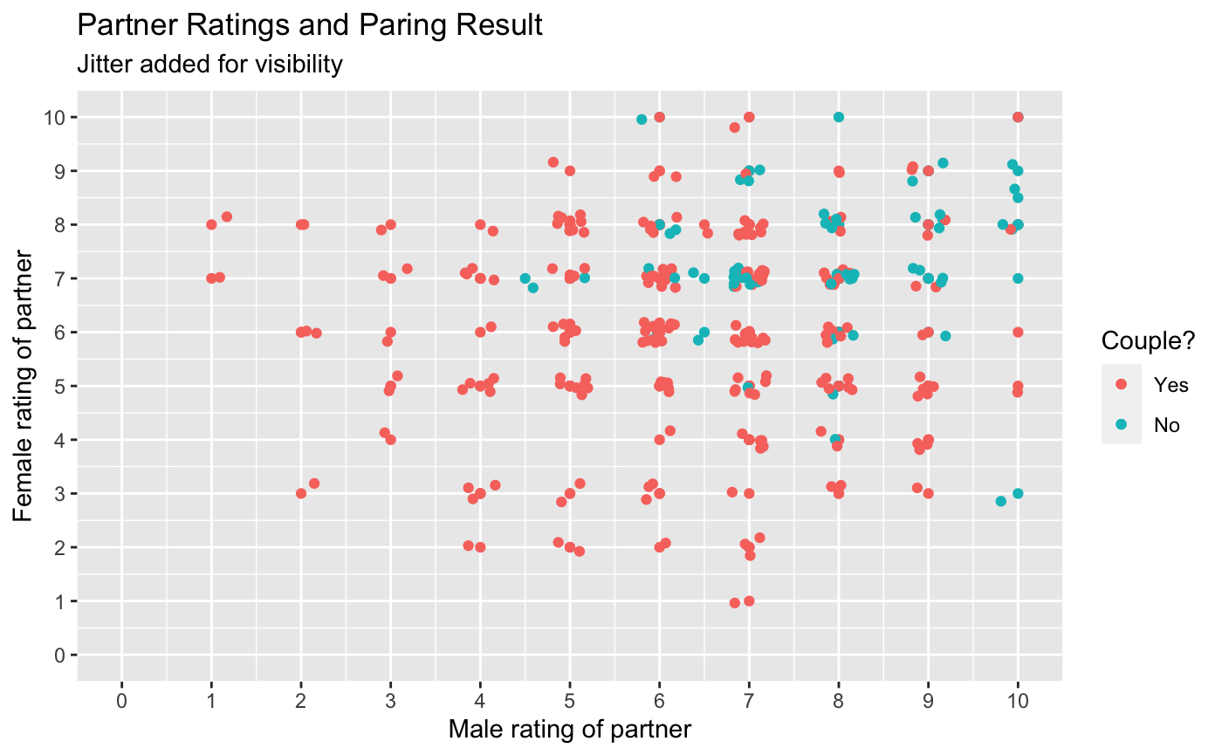
Grounding check
Interesting Stats:
Overall:
Avg male rating (of females): ~ 6.7
Avg female rating (of males): ~ 6.4
For Couples:
Avg male rating (of females): ~7.9
Avg female rating (of males): ~7.3
Pair to couple conversion rate: ~23%
Men wanted a second date over half (53%) the time while women wanted a second date less than half (46%) the time.
People rated a 7 or above by their partner went on a second date 61% of the time
Notes:
Grounding check! We can see that there is a correlation between ratings and pairs turning to couples. This is important to know because it allows us to confirm that the more two people like each other, the more likely they are to go on a second date.

Slide 6
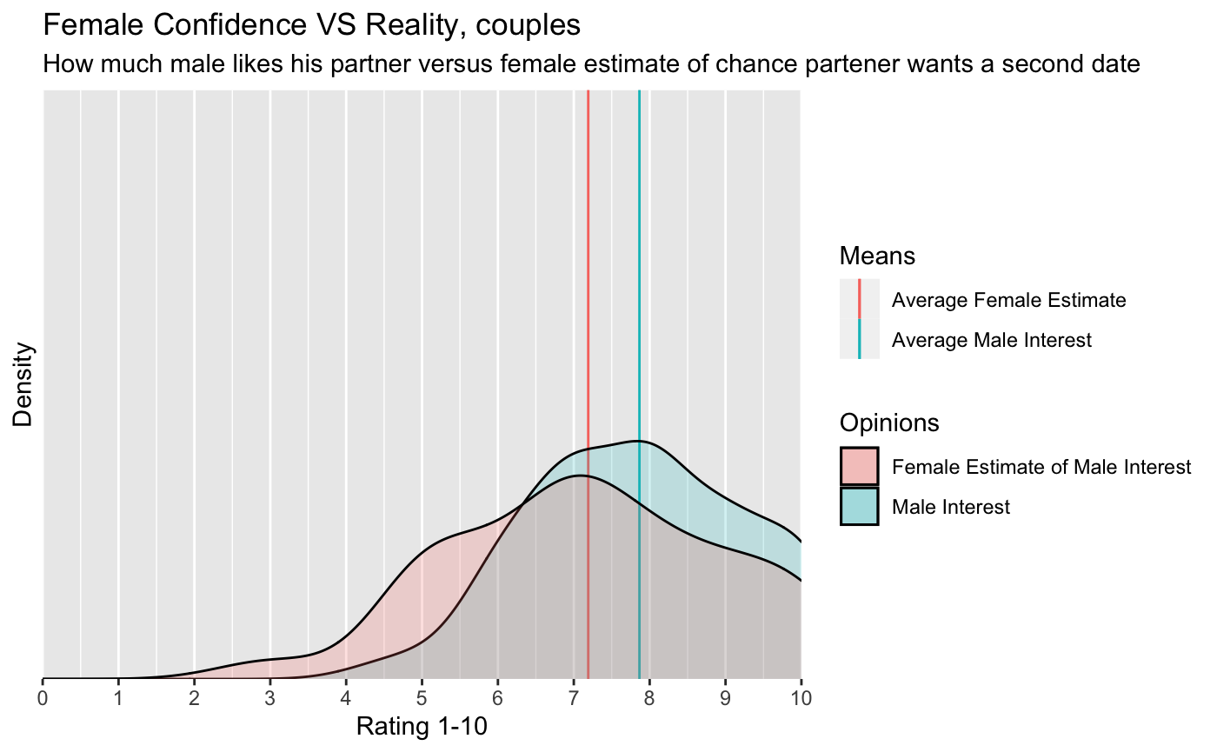
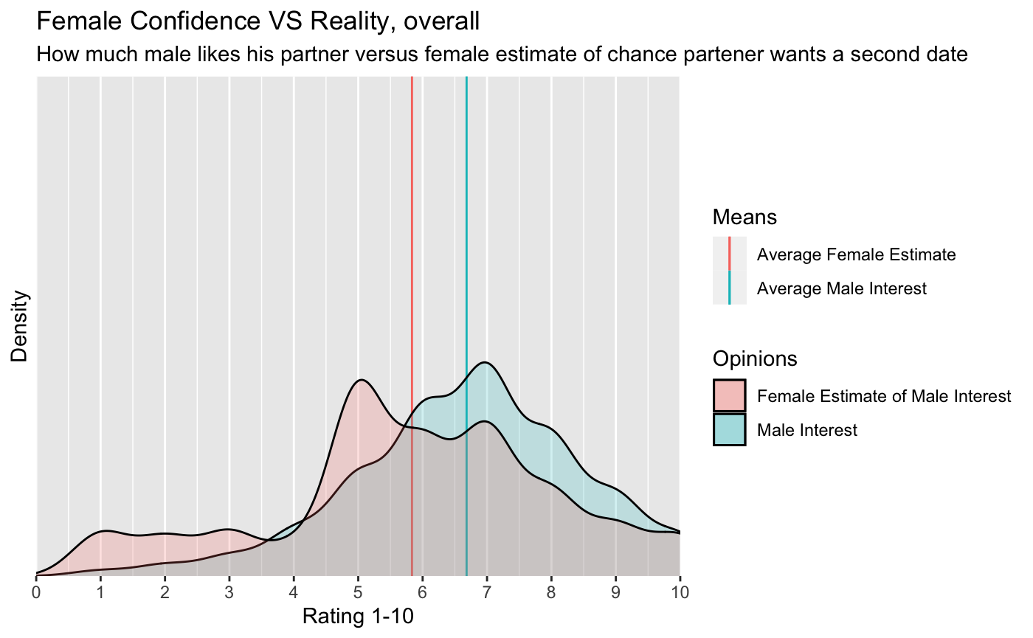
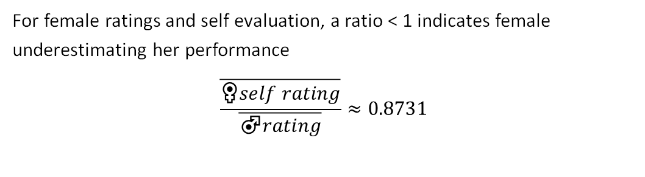
Overlaying sample estimates and ratings
For female ratings and self evaluation, a ratio < 1 indicates female underestimating her performance
$$\frac{\overline{♀self rating}}{\overline{♂rating}}≈0.8731$$
Notes:
Density is the % chance that a specific index will be picked randomly from the sample. We are now able to answer both questions from the start. We are okay at rating ourselves however we tend to consistently underestimate. Women and men tend to rate each other similarly however men rate females higher on average. Surprised that men actually underestimate their chances. A rating >6/7 is good enough to land you on a date.

Slide 7
Results
Key takeaways:
When dating, aim to be perceived as a “7” or higher
Both men and women tend to underestimate their performance in courtship
Future improvements:
Use an expanded dataset to include a larger number of samples
Diverse backgrounds
Different environments
Data from multiple sources
Data normalization and pre-processing
Connect research papers and studies

Slide 8
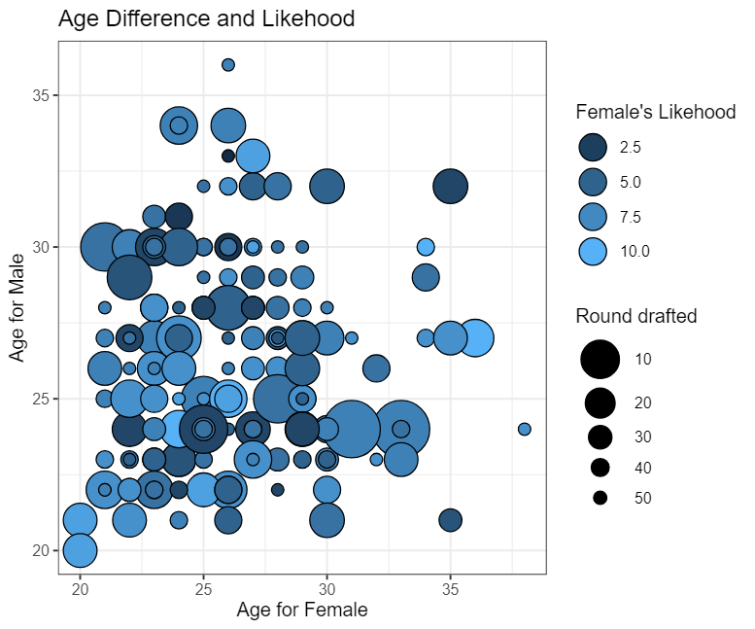
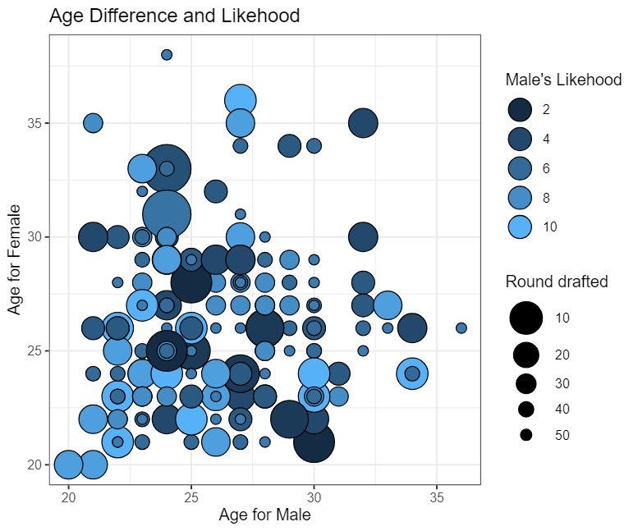
Age difference and likehood
For female high score concentrates at male in 20~30 and female 20~30
We cannot see other obvious relationship between them

Slide 9
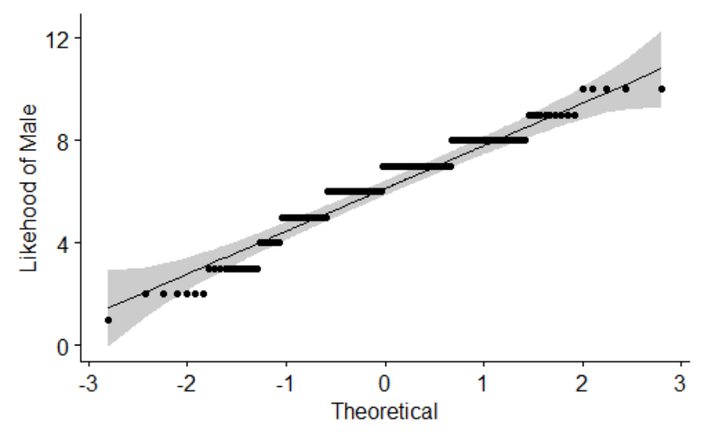
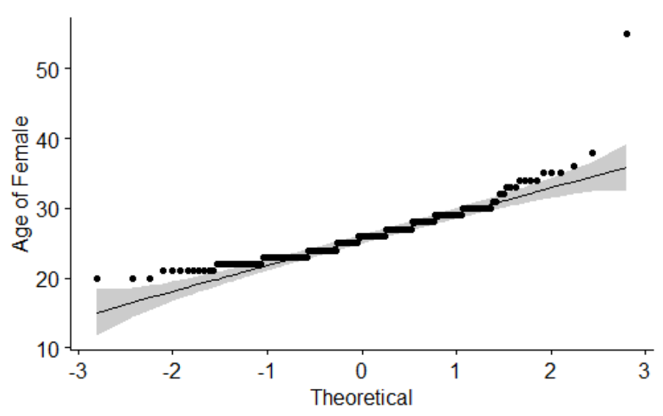
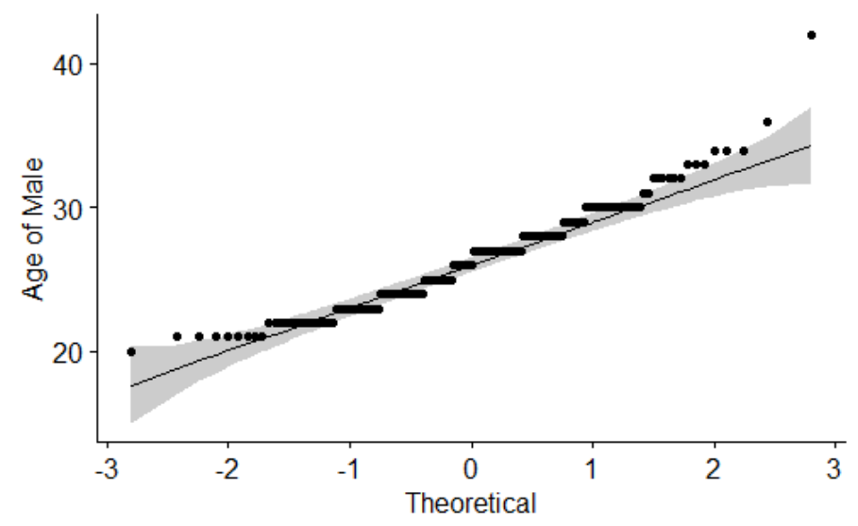
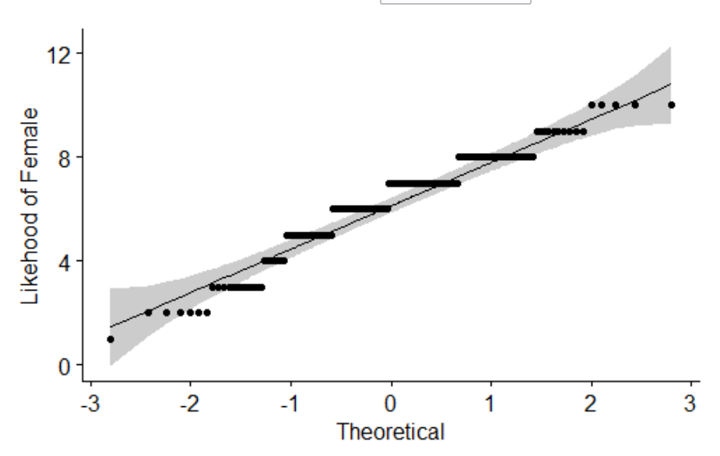
Normal distribution
The Age of female and male and the Like hood of male and female are all normal distribution.
Using Pearson correlation test to analyze the data

Slide 10
Age and likehood relation
data: AgeF and LikeM
t = -0.92625, df = 198, p-value = 0.3554
alternative hypothesis: true correlation is not equal to 0
95 percent confidence interval:
-0.20257868 0.07372914
sample estimates:
cor
-0.06568377
data: AgeM and LikeF
t = -0.23678, df = 198, p-value = 0.8131
alternative hypothesis: true correlation is not equal to 0
95 percent confidence interval:
-0.1552032 0.1222017
sample estimates:
cor
-0.01682452
For female, -0.0676 between 95% confidence interval
For male, -0.0168 between 95% confidence interval.
Age play a role in both gender, but more in female.

